Slide 1
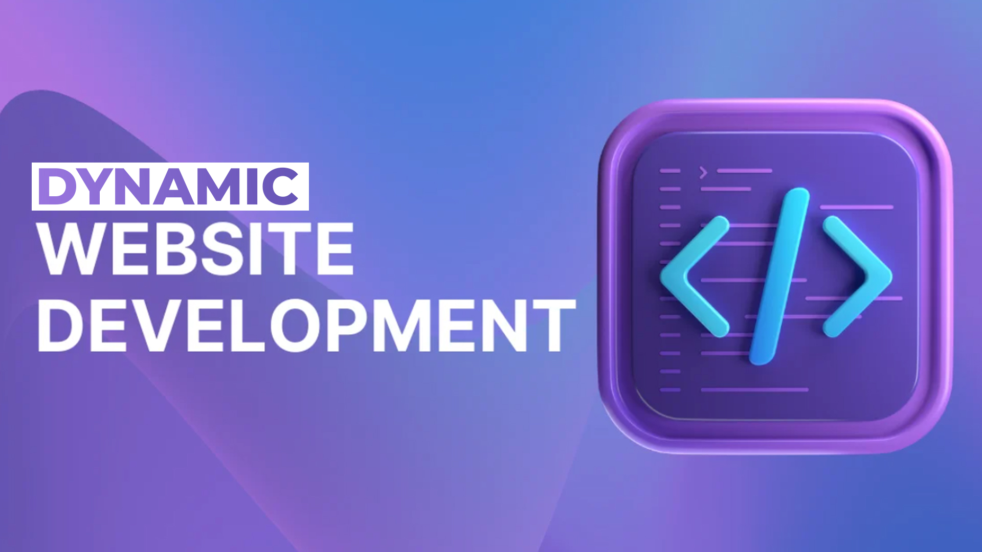

Slide 2
Introduction to Web Development
Week 1

Slide 3
Course Introduction
Web Development Fundamentals
Frontend Designing Basics
MySQL Database Management
PHP Programming
Dynamic Website Development
Authentication Systems
CRUD Applications
Final Web Project Development

Slide 4
Course Roadmap
Month 1
Web Fundamentals
HTML
CSS
JavaScript Basics
Month 2
MySQL Database
SQL Queries
PHP Fundamentals
Month 3
PHP + MySQL Integration
Login Systems
CRUD Applications
Final Project

Slide 5
What is a Website?
Definition
A website is a collection of web pages accessible through the internet.
Examples of Websites
Educational Websites
E-Commerce Websites
Bnking Systems
Social Media Platforms
News Portals
Common Website Features
Text
Images
Videos
Forms
Interactive Content

Slide 6
Types of Websites
Static Website
Features
Fixed Content
Simple Design
No Database
Faster to Develop
Example
Portfolio Website

Slide 7
Dynamic Website
Features of Dynamic Websites
Content Changes Dynamically
Database Connected
User Interaction
Login Systems
Admin Panels
Examples
Facebook
Daraz
YouTube
Online Banking Systems

Slide 8
Static vs Dynamic Website
Static Website
Dynamic Website
Fixed Content
No Database
Simple
Easy to Develop
Limited Functionality
Dynamic Content
Uses Database
Interactive
More Powerful
Advanced Features

Slide 9
How the Internet Works
Basic Flow
User Opens Browser
User Types Website Address
Request Sent to Server
Server Processes Request
Response Returned to Browser
Website Displayed to User

Slide 10
Client-Side vs Server Side
Client Side
Runs in Browser
HTML
CSS
JavaScript
Server Side
Runs on Server
PHP
Python
Node.js
ASP.NET

Slide 11
Frontend vs Backend Development
Frontend Development
User Interface
Website Design
User Experience
Technologies
HTML
CSS
JavaScript

Slide 12
Frontend vs Backend Development Contd...
Backend Development
Database Handling
Business Logic
Authentication
Technologies
PHP
MySQL

Slide 13
What is PHP?
PHP
Hypertext Preprocessor
PHP is a server-side scripting language used to create dynamic websites.
Features of PHP
Open Source
Easy to Learn
Database Connectivity
Fast Development
Widely Used

Slide 14
Popular Websites Using PHP
Examples
Facebook (Initially)
WordPress
Wikipedia
Mailchimp
Why Companies Use PHP?
Cost Effective
Flexible
Large Community Support

Slide 15
Introduction to Web Server
What is a Web Server?
A web server stores and delivers websites to users.
Examples
Apache Server
Nginx
IIS
For This Course
We will use:
XAMPP
Apache Server
MySQL
PHP

Slide 16
Introduction to XAMPP
What is XAMPP?
XAMPP is a local server package used for PHP development.
Components
X = Cross Platform
A = Apache
M = MySQL
P = PHP
P = Perl

Slide 17
Introduction to Visual Studio Code
VS Code
A lightweight and powerful code editor.
Features
Syntax Highlighting
Extensions Support
Auto Completion
Integrated Terminal
Extensions Recommended
PHP Intelephense
Live Server
Prettier

Slide 18
Development Environment Setup
Software Installation
Install:
XAMPP
VS Code
Google Chrome
Verify:
Apache Running
MySQL Running
Localhost Working

Slide 19
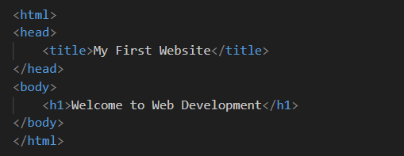
First Web Page
Basic HTML Example

Slide 20
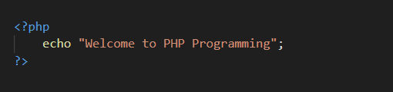
First PHP Program
PHP Example

Slide 21
Practical Activity
Hands-On Lab
Task 1
Create a simple HTML page containing:
Heading
Paragraph
Image
Hyperlink
Task 2
Run first PHP file using XAMPP.

Slide 22
Class Discussion
Questions for Students
What is the difference between static and dynamic websites?
What is the role of PHP?
What is a server?
Why do we use databases?

Slide 23
Assignment
Homework Task
Create A simple webpage containing:
Your Name
Introduction
Your Picture
Your Hobbies
One External Website Link
& Save File As:
aboutme.html

Slide 24
Summary
Today We Learned
Introduction to Web Development
Static vs Dynamic Websites
Client-side vs Server-side
Frontend vs Backend
Introduction to PHP
Introduction to XAMPP
VS Code Setup
First HTML & PHP Program

Slide 25
Q & A Time

